Slide 1
Android Layouts

Slide 2
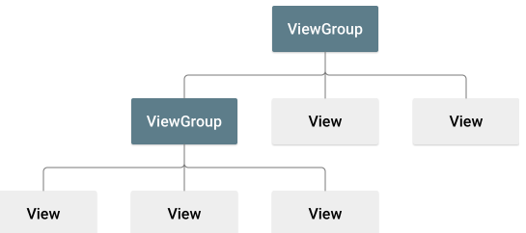
Layout
A layout defines the structure for a user interface in your app, such as in an activity.
All elements in the layout are built using a hierarchy of View and ViewGroup objects.
A View usually draws something the user can see and interact with.
Whereas a ViewGroup is an invisible container that defines the layout structure for View and other ViewGroup objects, as shown in figure below.

Slide 3
The View objects are usually called "widgets" and can be one of many subclasses, such as Button or TextView.
The ViewGroup objects are usually called "layouts" can be one of many types that provide a different layout structure, such as LinearLayout or ConstraintLayout.
In Android, a layout is a container that holds UI elements such as TextViews, Buttons, ImageViews, etc., and defines how they should be arranged on the screen.
There are several types of layouts available in Android, each with its own characteristics and usage scenarios.
Here are some of the most commonly used layouts in Android:
Linear Layout
Relative Layout

Slide 4
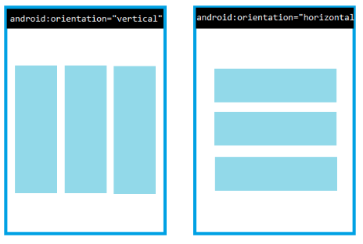
Linear Layout
LinearLayout is a simple layout that arranges its child elements either horizontally or vertically, depending on the orientation attribute.
It's a very basic layout, but it can be used for many UI elements, such as buttons, text fields, and labels.
LinearLayout is often used in simple UI screens where the elements are laid out in a linear order.

Slide 5
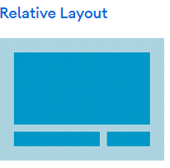
Relative Layout
RelativeLayout is a more complex layout that allows you to arrange UI elements relative to each other.
It provides more control over the placement of elements, making it a good choice for complex UIs.
It enables you to specify the location of child objects relative to each other (child A to the left of child B) or to the parent (aligned to the top of the parent).
For example, you might use RelativeLayout to create a UI with a centered image and a title overlaid on top of it.

Slide 6
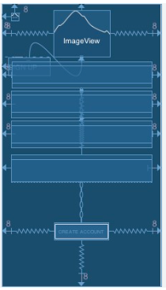
Constraint Layout
ConstraintLayout is a powerful layout that allows you to define complex relationships between UI elements.
It's similar to RelativeLayout, but with more advanced features, such as the ability to set constraints between elements.
For example, you can use ConstraintLayout to create a UI with two elements that are always the same distance apart, regardless of the size of the screen.

Slide 7
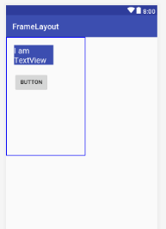
Frame Layout
FrameLayout is a simple layout that displays a single UI element at a time, usually taking up the entire screen.
It's commonly used for displaying fragments or dialogs.

Slide 8
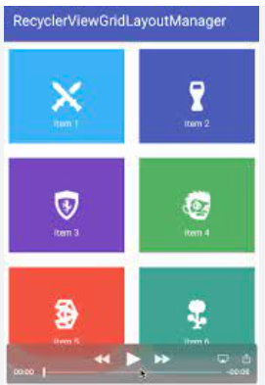
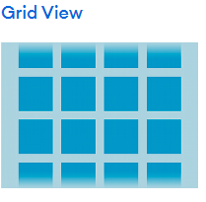
Grid Layout
GridLayout is a layout that arranges its child elements in a grid format.
It's a good choice for displaying data in a tabular format, such as a list of products with their prices and descriptions.

Slide 9
Coordinator Layout
CoordinatorLayout is a more advanced layout that provides additional features for coordinating the animations and behaviors of its child elements.
It's often used for creating complex UIs with multiple interacting elements, such as a floating action button that animates in response to scrolling.

Slide 10
Scroll View
ScrollView is a layout that allows you to scroll through a large amount of content that doesn't fit on the screen.
It's commonly used for displaying long lists or text content that would otherwise be too large to fit on the screen.

Slide 11
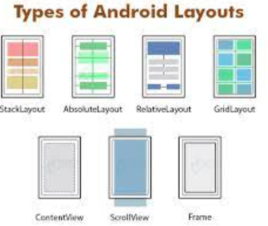
These are some of the most commonly used layouts in Android, but there are many more available as well.
The choice of layout depends on the specific requirements of the UI you are building and the desired user experience.

Slide 12
Attributes
Every View and ViewGroup object supports their own variety of XML attributes.
Some attributes are specific to a View object (for example, TextView supports the textSize attribute), but these attributes are also inherited by any View objects that may extend this class.
Some are common to all View objects, because they are inherited from the root View class (like the id attribute).
And, other attributes are considered "layout parameters," which are attributes that describe certain layout orientations of the View object, as defined by that object's parent ViewGroup object.

Slide 13
ID
Any View object may have an integer ID associated with it, to uniquely identify the View within the tree.
When the app is compiled, this ID is referenced as an integer, but the ID is typically assigned in the layout XML file as a string, in the id attribute.
This is an XML attribute common to all View objects (defined by the View class) and you will use it very often.
The syntax for an ID, inside an XML tag is:
android:id="@android:id/empty“
With the android package namespace in place, we're now referencing an ID from the android.R resources class, rather than the local resources class.

Slide 14
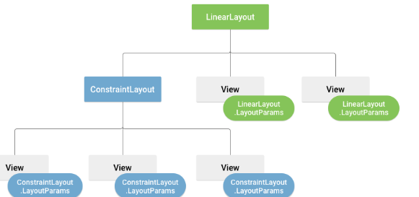
Layout Parameters
XML layout attributes named layout_something define layout parameters for the View that are appropriate for the ViewGroup in which it resides.
Every ViewGroup class implements a nested class that extends ViewGroup.LayoutParams.
This subclass contains property types that define the size and position for each child view, as appropriate for the view group.
As you can see in figure below, the parent view group defines layout parameters for each child view (including the child view group).

Slide 15
Every LayoutParams subclass has its own syntax for setting values. Each child element must define LayoutParams that are appropriate for its parent, though it may also define different LayoutParams for its own children.
LayoutParams are used by views to tell their parents how they want to be laid out.
All view groups include a width and height (layout_width and layout_height), and each view is required to define them.
Many LayoutParams also include optional margins and borders.
You can specify width and height with exact measurements, though you probably won't want to do this often.
More often, you will use one of these constants to set the width or height:
wrap_content tells your view to size itself to the dimensions required by its content.
match_parent tells your view to become as big as its parent view group will allow.
In general, specifying a layout width and height using absolute units such as pixels is not recommended.
Instead, using relative measurements such as density-independent pixel units (dp), wrap_content, or match_parent, is a better approach, because it helps ensure that your app will display properly across a variety of device screen sizes.

Slide 16
Layout Position
The geometry of a view is that of a rectangle.
A view has a location, expressed as a pair of left and top coordinates, and two dimensions, expressed as a width and a height.
The unit for location and dimensions is the pixel.
It is possible to retrieve the location of a view by invoking the methods getLeft() and getTop().
The former returns the left, or X, coordinate of the rectangle representing the view.
The latter returns the top, or Y, coordinate of the rectangle representing the view.
These methods both return the location of the view relative to its parent.
For instance, when getLeft() returns 20, that means the view is located 20 pixels to the right of the left edge of its direct parent
Methods getRight() and getBottom() return the coordinates of the right and bottom edges of the rectangle representing the view.

Slide 17
Size, Padding and Margins
The size of a view is expressed with a width and a height. A view actually possesses two pairs of width and height values.
The first pair is known as measured width and measured height. These dimensions define how big a view wants to be within its parent. The measured dimensions can be obtained by calling getMeasuredWidth() and getMeasuredHeight().
The second pair is simply known as width and height, or sometimes drawing width and drawing height. These dimensions define the actual size of the view on screen, at drawing time and after layout. These values may, but do not have to, be different from the measured width and height. The width and height can be obtained by calling getWidth() and getHeight().

Slide 18
Build a Responsive Layout with ConstraintLayout
ConstraintLayout lets you create large, complex layouts with a flat view hierarchy—no nested view groups.
It's similar to RelativeLayout in that all views are laid out according to relationships between sibling views and the parent layout, but it's more flexible than RelativeLayout and easier to use with Android Studio's Layout Editor.
All the power of ConstraintLayout is available directly from the Layout Editor's visual tools, because the layout API and the Layout Editor are specially built for each other.
You can build your layout with ConstraintLayout entirely by dragging instead of editing the XML.

Slide 19
Constraints Overview
To define a view's position in ConstraintLayout, you add at least one horizontal and one vertical constraint for the view.
Each constraint represents a connection or alignment to another view, the parent layout, or an invisible guideline.
Each constraint defines the view's position along the vertical or horizontal axis.
Each view must have a minimum of one constraint for each axis, but often more are necessary.
When you drop a view into the Layout Editor, it stays where you leave it even if it has no constraints. This is only to make editing easier. If a view has no constraints when you run your layout on a device, it is drawn at position [0,0] (the top-left corner).

Slide 20
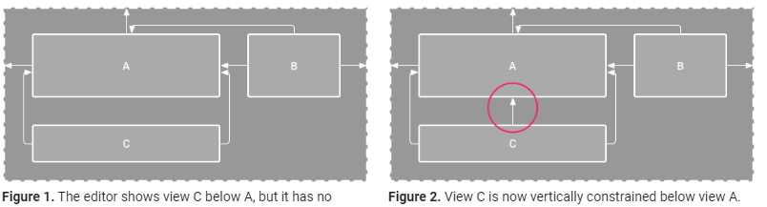
In figure 1, the layout looks good in the editor, but there's no vertical constraint on view C.
When this layout draws on a device, view C horizontally aligns with the left and right edges of view A, but it appears at the top of the screen because it has no vertical constraint.
Although the missing constraint do not cause a compilation error, the Layout Editor indicates missing constraints as an error in the toolbar.
To view the errors and other warnings, click Show Warnings and Errors.
To help you avoid missing constraints, the Layout Editor automatically adds constraints for you with the Autoconnect and infer constraints features.

Slide 21
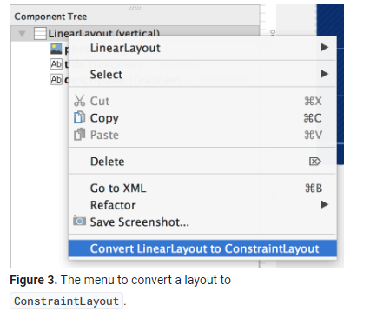
Convert a Layout
To convert an existing layout to a constraint layout, follow these steps:
Open your layout in Android Studio and click the Design tab at the bottom of the editor window.
In the Component Tree window, right-click the layout and click Convert LinearLayout to ConstraintLayout.

Slide 22
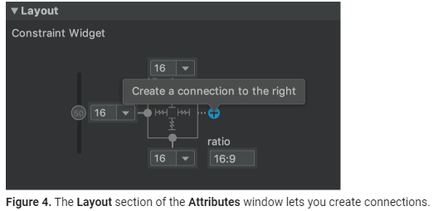
Add or Remove a Constraint
To add a constraint, do the following:
Drag a view from the Palette window into the editor. When you add a view in a ConstraintLayout, it displays in a bounding box with square resizing handles on each corner and circular constraint handles on each side.
Click the view to select it.
Do one of the following:
Click a constraint handle and drag it to an available anchor point. This point can be the edge of another view, the edge of the layout, or a guideline. Notice that as you drag the constraint handle, the Layout Editor shows potential connection anchors and blue overlays.
Click one of the Create a connection buttons in the Layout section of the Attributes window, as shown in figure 4.

